Slide 1
Section 2.4: Cells and Energy
You will need a pencil and your notes sheet. This will be provided for you.

Slide 2
Daily Question
What happens when you breathe?
Air (containing O₂ moves into the lungs and air (containing CO₂ ) moves out of the lungs.
Do cells breathe?
Cells do not have lungs and cannot breathe. However, O₂ and CO₂ move into and out of cells.

Slide 3
Cellular Respiration Video

Slide 4
Cellular Respiration
All living things need energy to survive.
Cellular respiration is a series of chemical reactions that convert the energy in food into a usable form of energy called ATP.

Slide 6
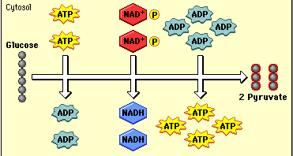
Reactions in the Cytoplasm
Step 1: Glycolysis
The process by which a sugar called glucose is broken down into smaller molecules.
Some ATP is produced, some ATP is used.
Net of 2 ATP
The smaller molecules are used in the next step.
Pyruvate

Slide 7
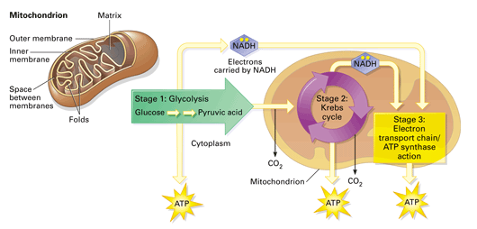
Reactions in the Mitochondria
Step 2: Respiration
This step uses oxygen (O₂ ) – aerobic process
Large amounts of ATP (34) are produced from the molecules (pyruvic acid) made during glycolysis.
The byproducts are water and CO₂

Slide 8
Daily Question – On the front desk

Slide 9
Fermentation
Fermentation is a reaction that eukaryotic and prokaryotic cells use to obtain energy from food when oxygen levels are low (anaerobic process).
Fermentation will occur in the cytoplasm not the mitochondria (where cellular respiration takes place).
Makes less ATP (energy) than cellular respiration.
Fermentation with sugar video

Slide 10
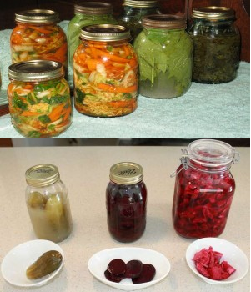
Lactic Acid Fermentation
If oxygen (or not enough) is not available, cells will go through glycolysis but will not be able to go through respiration.
Lactic acid will be created along with 2 ATP.
Occurs in muscle (during exercise), bacteria and fungi that help produce cheese, yogurt and sour cream.

Slide 11
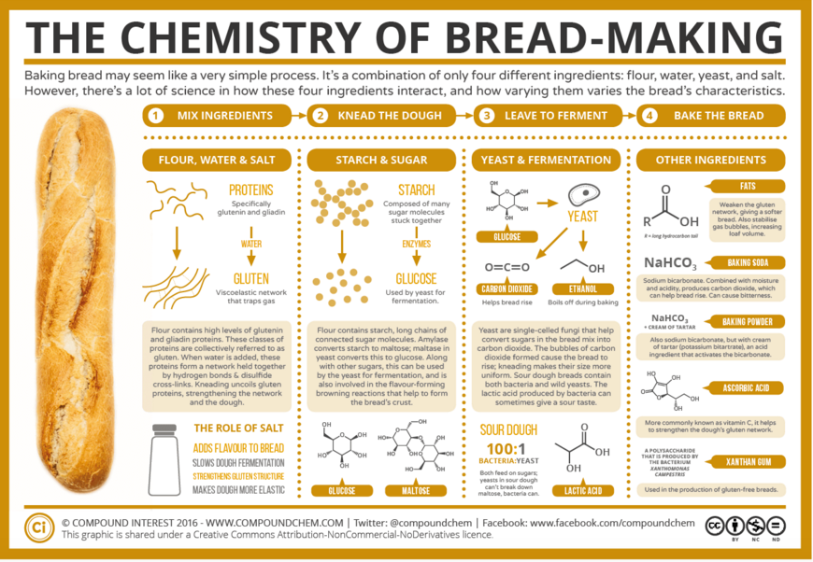
Alcoholic Fermentation
Some bacteria and yeast create ATP (2) through alcoholic fermentation.
Still does not require oxygen.
Creates 2 ATP, CO₂ and ethanol (alcohol), not lactic acid
Many uses
Bread making
Brewers

Slide 12
Review
Fermentation and cellular respiration both use what process to start?
Glycolysis
Which process creates the most energy (ATP)?
Cellular Respiration
Glycolysis and both types of fermentation are considered anaerobic. Why?
They do not use oxygen.
What are the two types of fermentation?
Lactic acid fermentation and alcohol fermentation

Slide 13
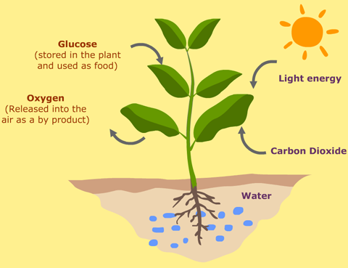
Photosynthesis
Plants and some unicellular organisms obtain energy from light.
Photosynthesis is a series of chemical reactions that convert light energy, water and carbon dioxide into the food-energy molecule glucose and the waste product oxygen.

Slide 14
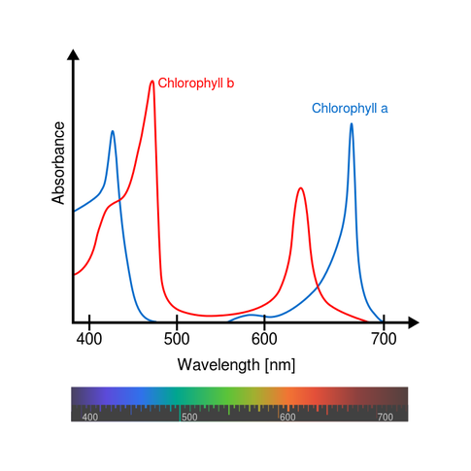
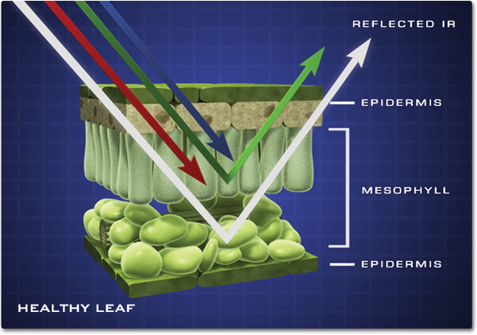
Light and Pigments
Pigments such as chlorophyll absorb light energy.
Absorbs all colors except green (reflected back/what we see).

Slide 15
Reactions in Chloroplasts
Chlorophyll absorbs light in chloroplasts.
Chloroplasts convert the light energy to chemical energy and then to food.
Raw Materials (reactants)
Water (H₂O)
Carbon Dioxide (CO₂)
Products
Glucose (C₆H₁₂O₆)
Oxygen (O₂)

Slide 16
Chemical Formulas
The number of atoms that the formula starts with needs to be the same as it ends with.
The formula needs to be balanced.
Reactants are what you start with.
Products are what is made when the process is done.
The → indicates a change is made.
If there is something written over the arrow, it is neither a reactant or product but something needed for the change.

Slide 17
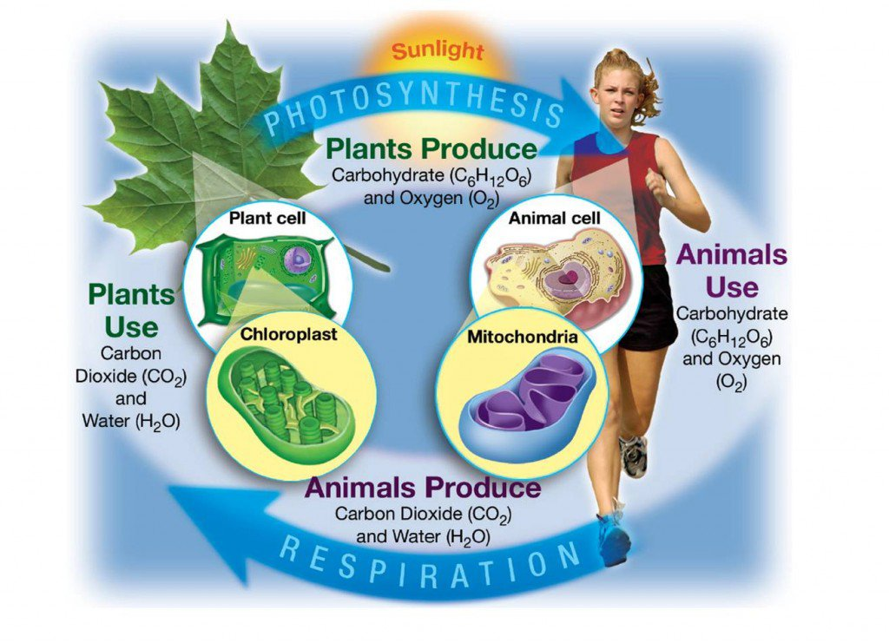
Importance of Photosynthesis
Photosynthesis uses carbon dioxide that is released during cellular respiration to make food energy and release oxygen.
When an organism eats plant material, it takes in food energy. An organism’s cells use oxygen released during photosynthesis.

